Slide 1
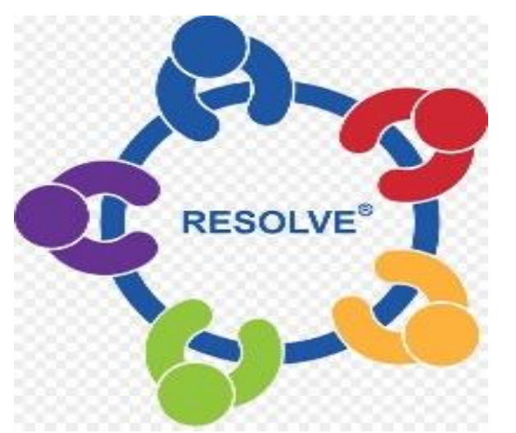
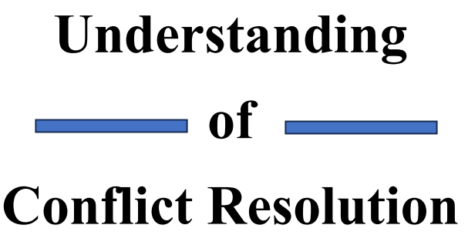

Chapter Three: COMMUNICATION OF CONFLICT RESOLUTION

Slide 2

Introduction
Communication plays a crucial role in conflict resolution. Effective communication is a strong tool in conflict resolution. It allows individuals or parties involved in a conflict to express their perspectives, needs, and concerns, while also fostering understanding and finding mutually agreeable solutions.
Remember that effective communication takes practice, patience, and a willingness to collaborate.

Slide 3
Key Principles And Strategies For Communication In Conflict Resolution
Active Listening: Actively listening to the other party's viewpoint is essential.
Use "I" Statements: When expressing your concerns or viewpoints, use "I" statements to avoid sounding accusatory or confrontational.
Clarify and Paraphrase: To ensure accurate understanding, clarify and paraphrase what the other person has said.
Remain Calm and Respectful: Keep emotions in check and maintain a respectful tone, even if the conversation becomes heated.
Focus on Interests, Not Positions: Help shift the focus from rigid positions to underlying interests

Slide 4
Key Principles And Strategies For Communication In Conflict Resolution
Collaborative Problem-Solving: Foster a collaborative environment where both parties work together to find a mutually beneficial solution. Encourage brainstorming and open-mindedness to explore various options and alternatives.
Seek Win-Win Solutions: Aim for win-win outcomes where both parties' interests are met to the greatest extent possible.
Non-Verbal Communication: Pay attention to non-verbal cues such as body language, facial expressions, and tone of voice. These cues can provide valuable insights into the other person's emotions and attitudes.

Slide 5
Key Principles And Strategies For Communication In Conflict Resolution
Time and Place: Choose an appropriate time and private space for discussions to ensure privacy, minimize distractions, and create a safe environment for open and honest communication.
Mediation or Facilitation: In more complex or challenging conflicts, consider involving a neutral third party, such as a mediator or facilitator, who can help guide the communication process and ensure fairness.

Slide 6
What does it mean “ I” statement?
"I" statements focus on the speaker's own thoughts, feelings, and experiences. Using "I" statements can improve communication, increase trust, and lead to stronger relationships. To use "I" statements effectively, focus on your own emotions and perceptions, and avoid attacking or blaming others.

Slide 7
Types of Communication in Conflict Resolution
In conflict resolution, various types of communication can be used to address and resolve conflicts:
Assertive Communication: Assertive communication involves expressing your thoughts, feelings, and needs directly and respectfully.
Nonviolent Communication: It emphasizes expressing oneself honestly and empathetically, while also empathetically listening to others.

Slide 8
Types of Communication in Conflict Resolution
Mediation Communication: Mediation involves the use of a neutral third party, the mediator, to facilitate communication and negotiation between conflicting parties.
Collaborative Communication: Collaborative communication emphasizes cooperation and joint problem-solving. It involves open and constructive dialogue between parties, where each person actively contributes ideas and works together to find mutually beneficial solutions.
Facilitative Communication: Facilitative communication involves the use of a facilitator who guides the communication process in a conflict resolution setting.

Slide 9
Characteristics of Communication of Conflict Resolution
Identification and understanding: Effective communication in conflict resolution requires the ability to understand others and recognize their emotions, concerns, and viewpoints
Respectful and constructive language: Communication in conflict resolution should be conducted with respect
Problem-solving orientation: Communication in conflict resolution should be focused on problem-solving rather than winning an argument or proving one's superiority.

Slide 10
Characteristics of Communication of Conflict Resolution
Time and patience: Conflict resolution communication requires time and patience. It involves allowing each party to express their thoughts and emotions fully, without rushing the process.
Focus on future relationships: Communication in conflict resolution should aim to preserve or improve future relationships between the parties involved. It involves considering the long term implications of the conflict and finding resolutions that promote trust, respect, and continued collaboration.

Slide 11
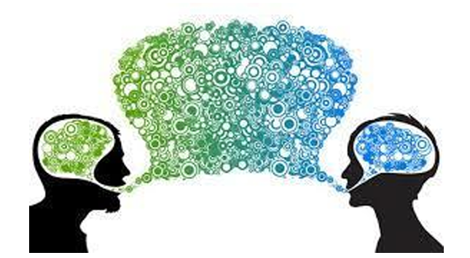
Importance of Communication in Conflict Resolution
Generally, the importance of communication in conflict resolution supports understanding, compassion, problem-solving, and collaboration.
Communication plays a vital role in conflict resolution for several reasons:
Expression of Perspectives: Effective communication allows parties involved in a conflict to express their perspectives, concerns, and emotions.

Slide 12
Importance of Communication in Conflict Resolution
Building Trust and Rapport: Open and honest communication helps build trust and rapport between conflicting parties.
Clarifying Misunderstandings: Misunderstandings and misinterpretations are common sources of conflict.
Finding Common Ground: Through communication, parties can identify shared interests, values, or goals
Emotional Expression and Empathy: Effective communication provides a platform for individuals to express their emotions constructively.

Slide 13
Importance of Communication in Conflict Resolution
Generating Creative Solutions: Communication encourages brainstorming and the exploration of alternative solutions. By engaging in open dialogue, parties can generate creative ideas and options that go beyond their initial positions
Maintaining Relationships: Communication allows parties to address the conflict respectfully and constructively, reducing the likelihood of long-term damage to relationships and facilitating future collaboration.

Slide 14
COMMON BARRIERS TO EFFECTIVE COMMUNICATION IN CONFLICT RESOLUTION
The common barriers to effective communication in conflict resolution are:
Emotional barriers: Strong emotions such as anger, fear, or frustration can make it difficult for individuals to communicate effectively.
Lack of active listening: When individuals fail to listen actively, they may miss important information
Language barriers: Communication can be obstructed when parties involved in conflict have different native languages or levels of know-how in a common language.

Slide 15
COMMON BARRIERS TO EFFECTIVE COMMUNICATION IN CONFLICT RESOLUTION
Lack of clarity and conciseness: When individuals are unclear or use confusing language, it can lead to confusion, misunderstandings, and conflicts.
Lack of trust: When parties involved in a conflict do not trust each other, it can be challenging to establish open and honest communication, blocking the resolution process.
Cultural differences: Different cultural norms, values, and communication styles can lead to misunderstandings and misinterpretations.

Slide 16
Role of Active Listening in Conflict Resolution
Active listening plays a crucial role in conflict resolution by fostering understanding, empathy, and effective communication between the parties involved.
As a result of actively listening to conflict resolution, individuals can overcome barriers, gain insights, and work towards finding resolutions that address the underlying issues.
Active listening promotes a collaborative and empathetic approach, enabling parties involved to move from adversarial positions towards mutually agreeable outcomes.

Slide 17
Role of Active Listening in Conflict Resolution
The following are the key roles of active listening in conflict resolution:
Improving understanding
Building understanding
Creating a safe space
Preventing misinterpretations
Managing emotional intensity
Encouraging collaboration
Strengthening relationships

Slide 18
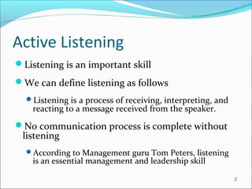

Slide 19
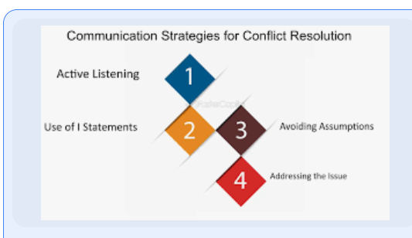

Slide 20
Chapter assessment( questions)
1) what is an effective communication?
2) explain what “I” statement focuses on.
3) List the characteristics of communication of conflict resolution
4) State the Role of Active Listening in Conflict Resolution
5) differentiate :
a) Generating Creative Solutions
b) Maintaining Relationships.
6) what would you do , if you see people who are in a serious conflict?
7) give an example of Emotional barriers.

